Slide 1
Independent Component Analysis for EEG Classification
Sarah Li

Slide 2
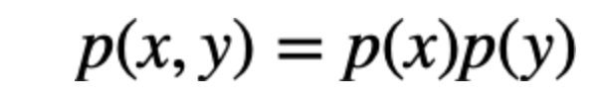
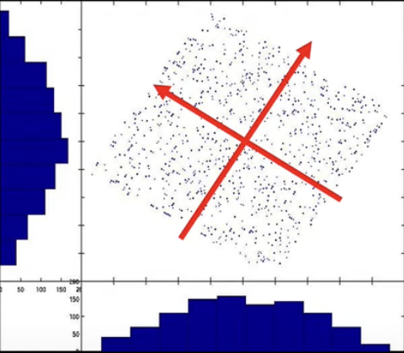
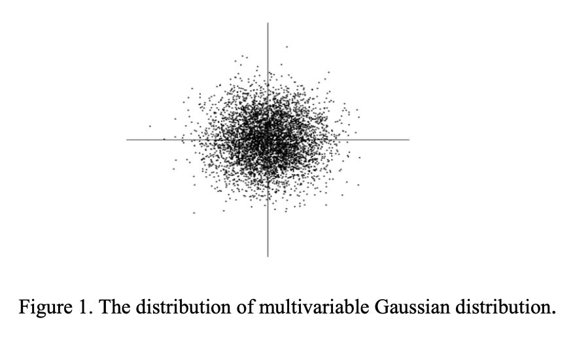
ICA Assumptions
Sources are statistically independent
2. The independent components are Non-Gaussian
3. Signals are linearly mixed (likely given CLT)
Notes:
If all sources are Gaussian, the joint distribution is symmetric (like a circle or sphere in 2D/3D), so any rotation of the axes is equally valid. There’s no unique way to identify the original sources because the data looks the same from any rotated perspective
If sources are non-Gaussian, their distributions have unique "shapes" (e.g., skewed, heavy-tailed), which ICA uses to identify the correct orientation (rotation) that makes the components independent.
The linear mixture assumption means that the observed signals are modeled as linear combinations of statistically independent source signals, with no nonlinear interactions between sources. ICA seeks to unmix the data by finding directions in which the distribution is maximally non-Gaussian
Data should be pre-whitened (sphered) before applying ICA for better convergence

Slide 3
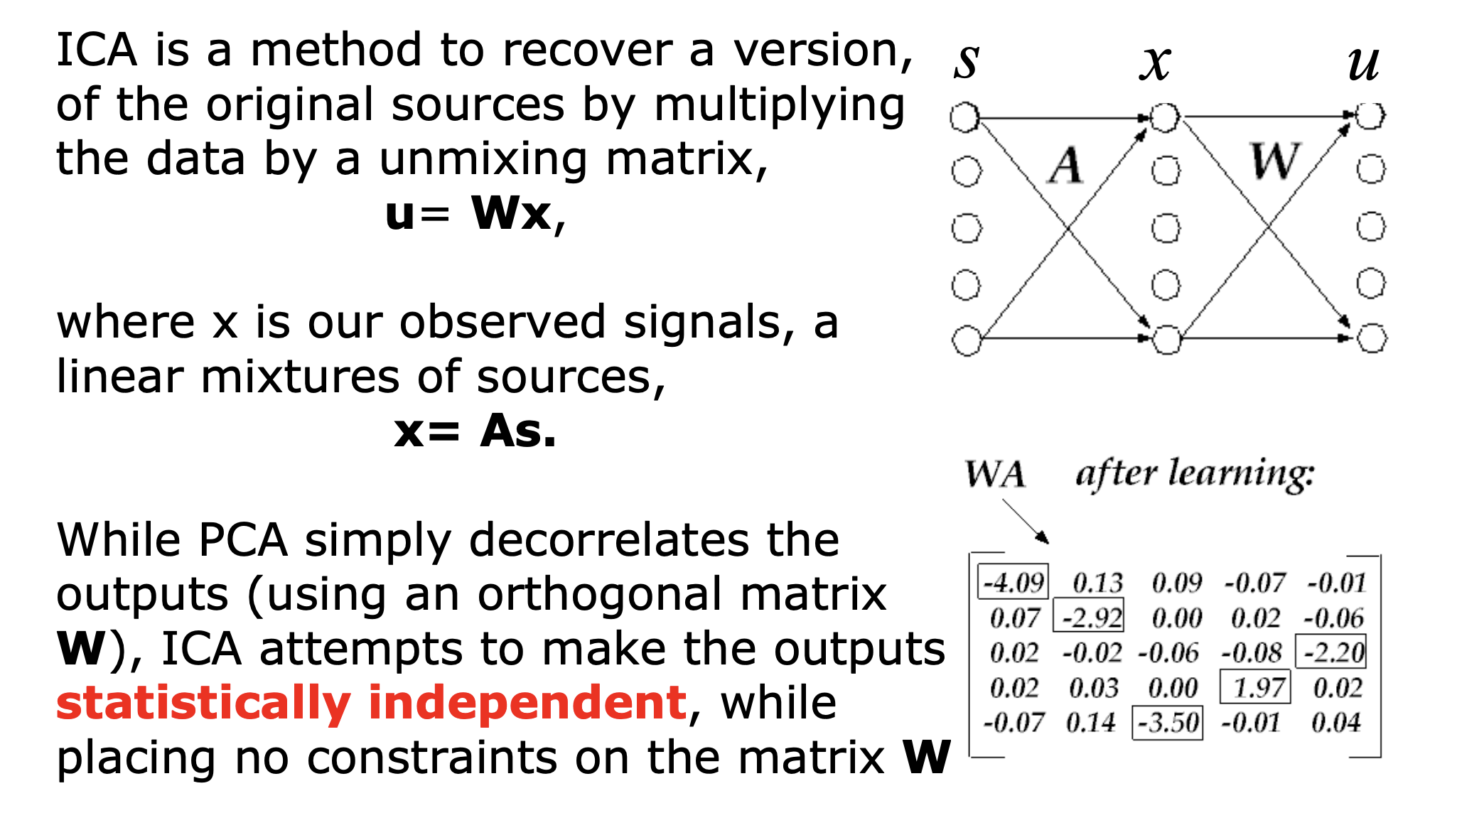
How ICA Works
Unsupervised Blind Source Separation (BSS) Problem
Notes:
In practice, both the sources s and the mixing matrix A are unknown. ICA algorithms estimate both simultaneously, using only the observed data x. After estimating A as W, its inverse is used to recover the sources
Columns of A denote how much each sources contributes to the original signal
Goal is for WA = I identity matrix

Slide 4
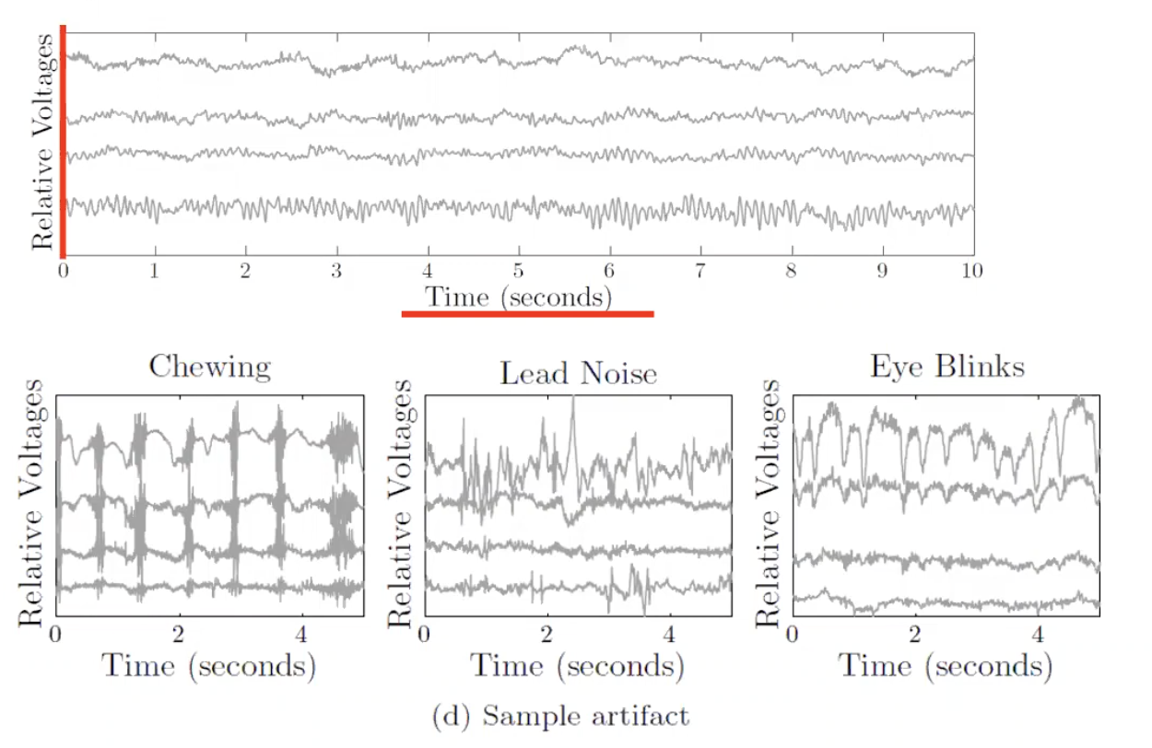
How ICA can be Applied to EEG Data
Muscle and motion artifacts that interfere with neural activity introduce noise
Notes:
Artifacts
Challenge of EEG data analysis is that the nature of the electrodes introduces a lot of noise

Slide 5
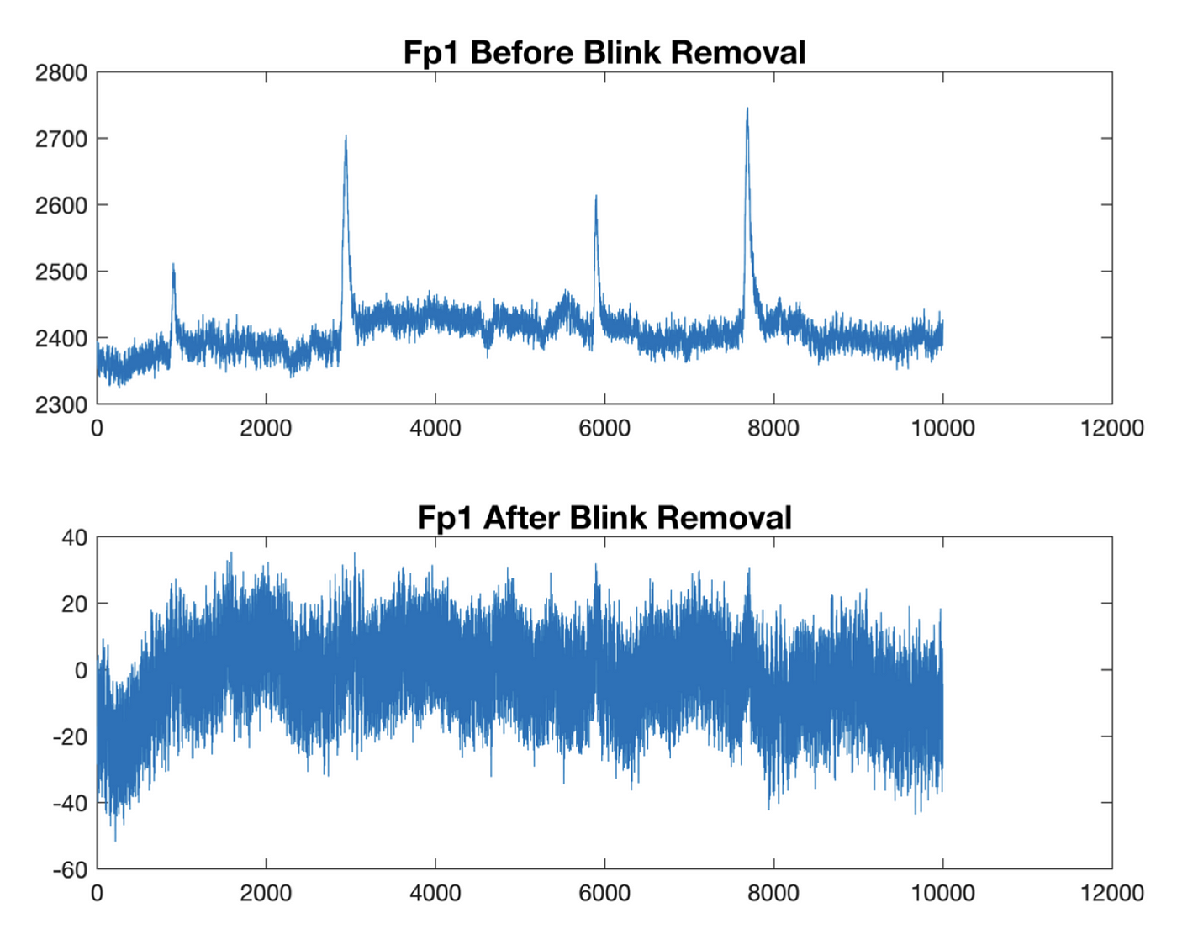
Notes:
No research results, nothing substantial (often performance worse)
Downside of ICA: Requires sufficient EEG channels and some prior knowledge for component selection
Other methods include Wavelet Transforms, regression-based methods

Slide 6
Evaluating ICA-Based Artifact Removal for EEG Motor Task Classification

Slide 7
Dataset
PhysioNet EEG Motor Movement/Imagery Database
(EEGMMIDB)
Feature | Description
Number of subjects | 4
Epochs | 1392
Sampling rate | 160 Hz (80 Nyquist)
Epoch duration | 4.5 seconds (−0.5 to 4.0 sec)
Number of channels | 64 (standard 10-20 montage)
Event classes | Rest, Left fist, Right fist, Feet
Runs | 14

Slide 8
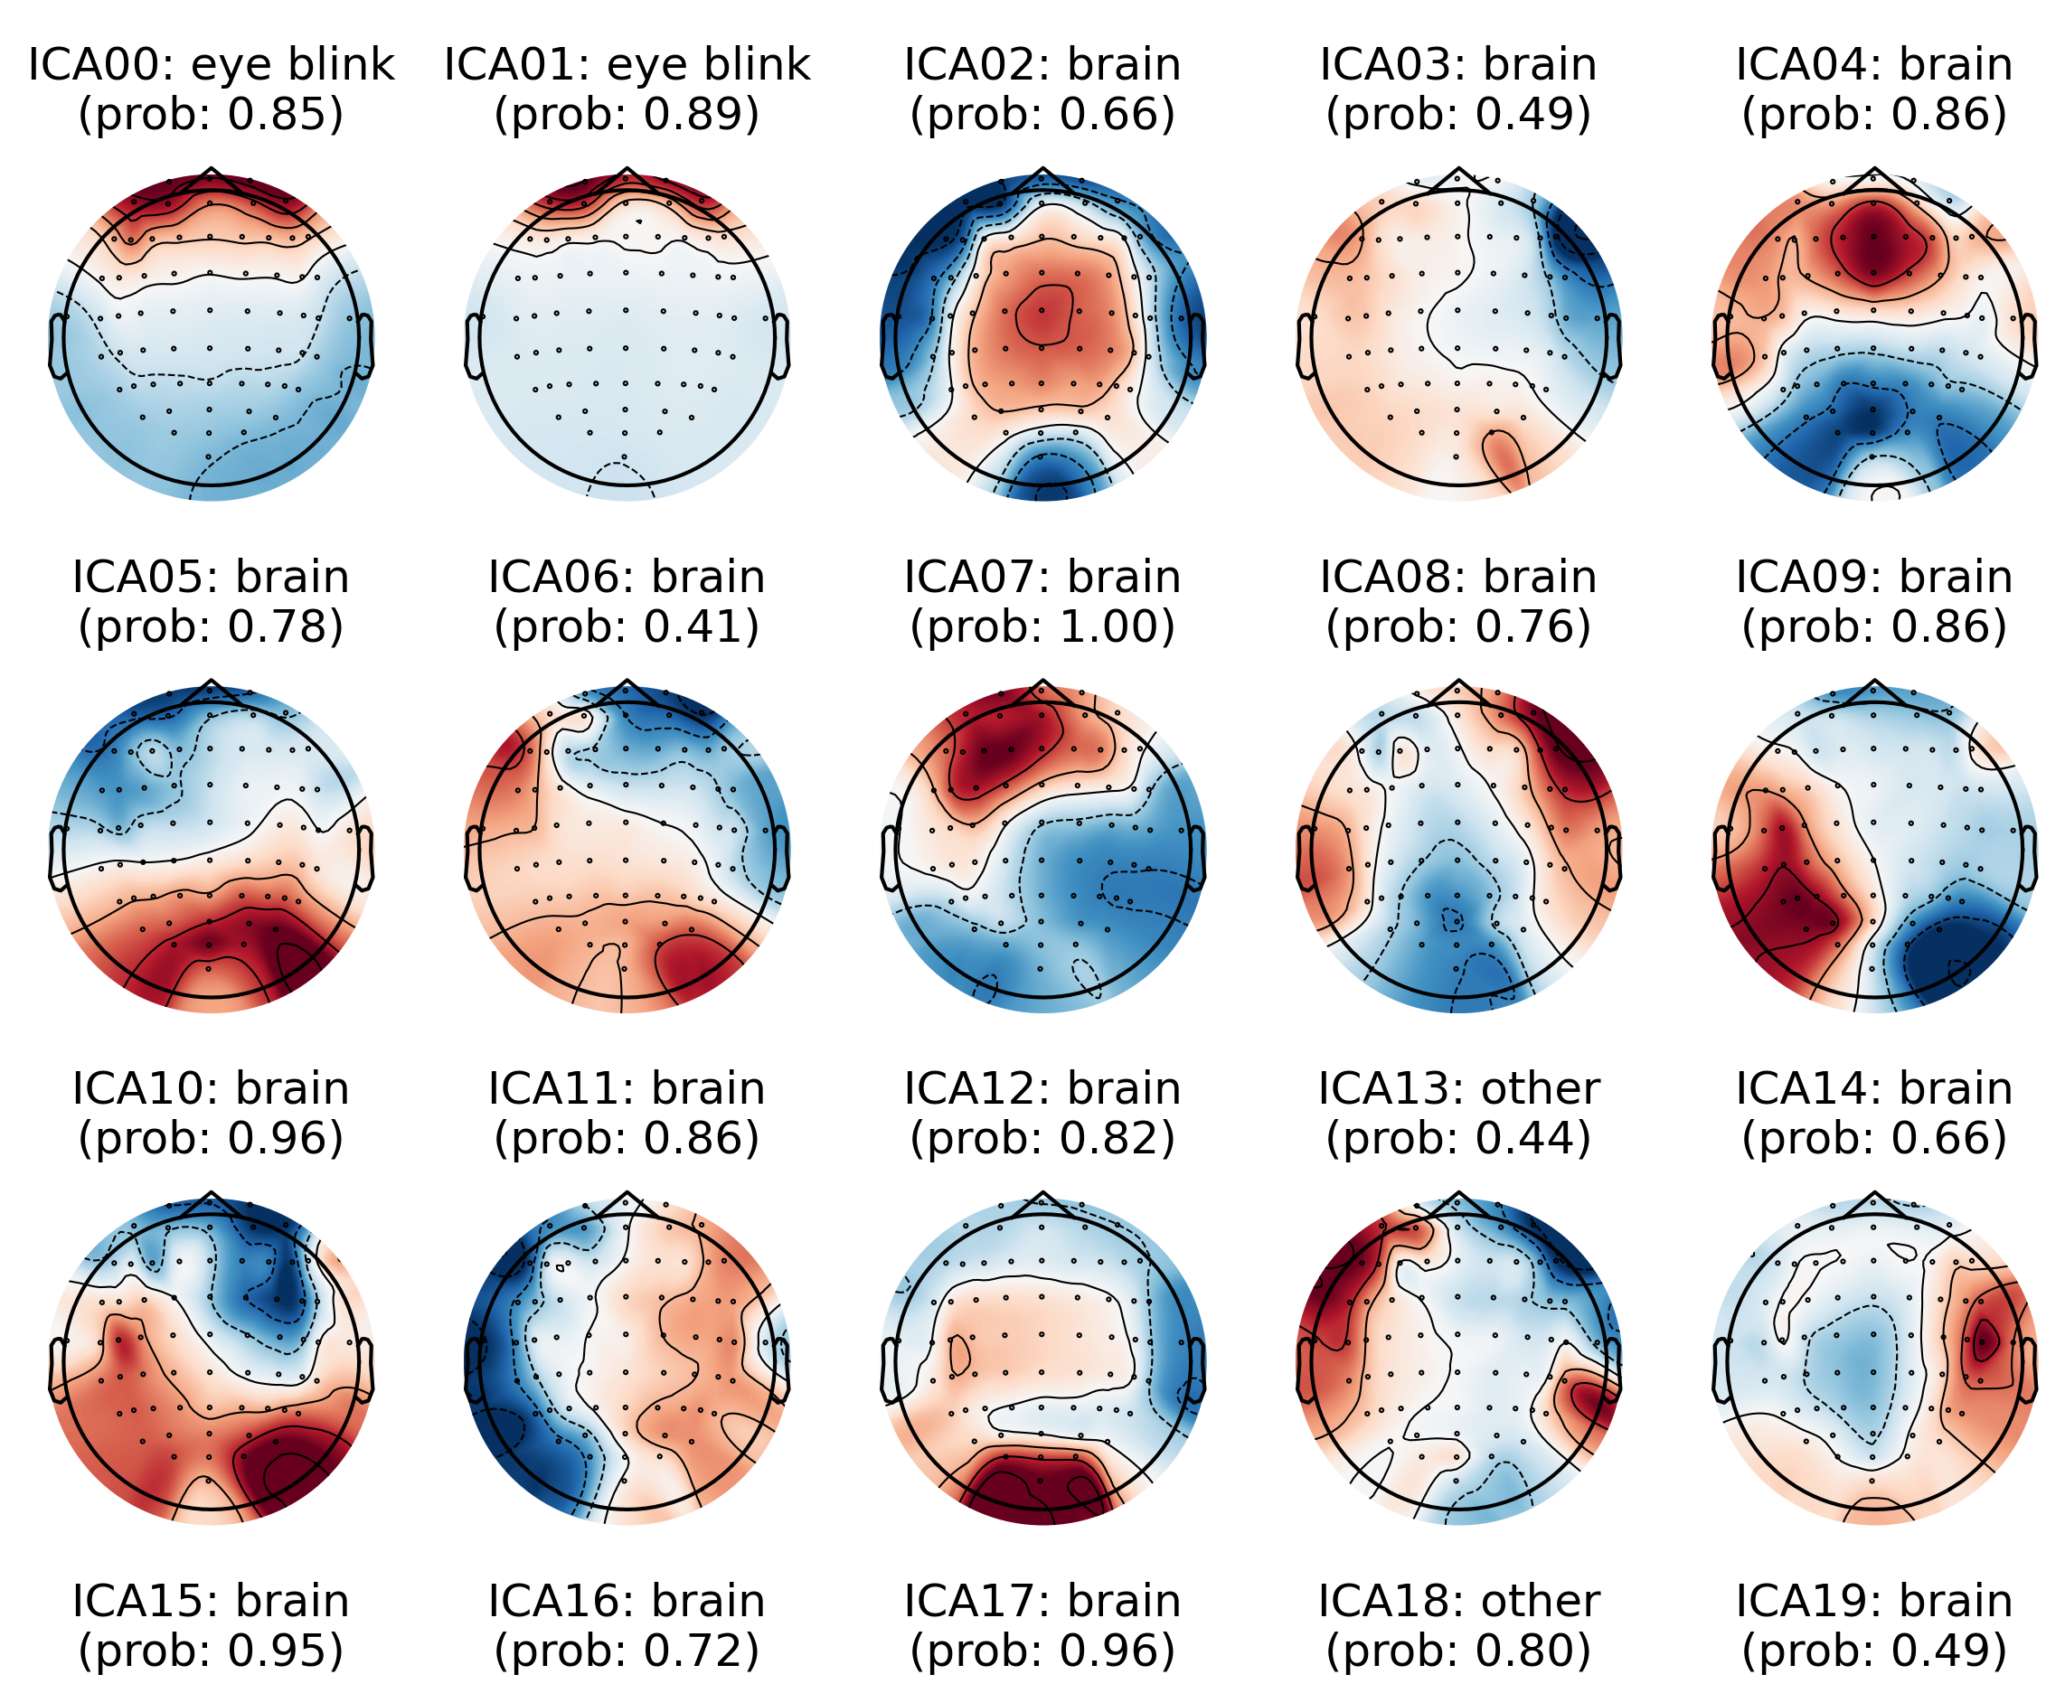
Example: Removing non-neural Artifacts through ICA
Red:
High Activity
Notes:
Here, the artifats correspond to non-brain activity are removed before re
contructing the data

Slide 9
The Following Models were used for Classification
Random Forest & Multilayer Perceptron
Hyperparameter tuning
5-fold Cross Validation
Feature Extraction
Frequency-domain (PSD), Short-Time Fourier Transform (STFT), Hjorth parameters (signal variation), Skewness & Kurtosis (distribution shape), and Common Spatial Patterns (CSP)
EEGNet
designed to classify EEG based BCI data
temporal convolution → spatial convolution → separable convolution

Slide 10
Model Performance Results
Data | Model | Hyperparameters | Accuracy
Raw EEG | Random Forest | estimators: 100; min_sample_split : 2, min_sample_leaf: 2; max_depth: 10 | 0.624
ICA Cleaned | Random Forest | estimators: 200, min_samples_split: 5, min_samples_leaf: 4; max_depth: 10} | 0.609
Raw EEG | MLP | max iterations: 200; lr: 0.001; hidden layer size: 100; activation: ReLU | 0.661
ICA Cleaned | MLP | max iterations: 400; lr: 0.001; hidden layer size: 5; activation: ReLU | 0.667
Raw EEG | EEGNet | activation: ELU; optimizer: Adam; lr=0.001; weight decay: 1e-4; epochs: 50 | 0.707
ICA Cleaned | EEGNet | activation: ELU; optimizer: Adam; lr=0.001; weight decay: 1e-4; epochs: 31 | 0.684

Slide 11
Discussion
Limited sample size and class imbalance:
4 subjects were analyzed due to computational constraints
Majority Rest/Baseline epochs
Over-aggressive automated artifact removal
Automated ICLabel algorithm likely removed task-relevant neural signals
EEGNet Best Performance (70.7%)
demonstrates that domain-specific architectures with built-in regularization can effectively handle noisy EEG data
Efficiency vs. accuracy trade-off
No evidence ICA cleaning helped accuracy
Faster model converge

